Slide 1



PROJECT
ON-PAGE SEO AUDIT AND OPTIMIZATION
BY KRISH RANA

Slide 2

Introduction
ON-PAGE SEO AUDIT AND OPTIMIZATION
MyCaptain is an online learning platform offering skill-based courses and mentorship
On-page SEO plays a crucial role in improving search engine rankings and user experience
An on-page SEO audit was conducted to evaluate and optimize key website elements

Slide 3
Our Objectives
Improve search engine visibility of MyCaptain’s web pages
Optimize on-page elements such as meta tags, headings, and content
Enhance user experience and engagement
Align content with search intent and target keywords

Slide 4
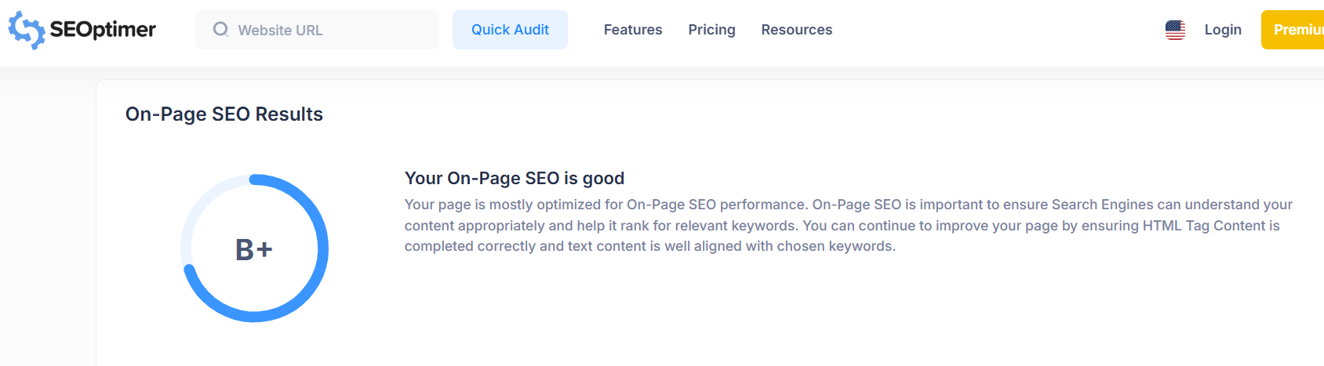
On - page SEO Audit

Slide 5
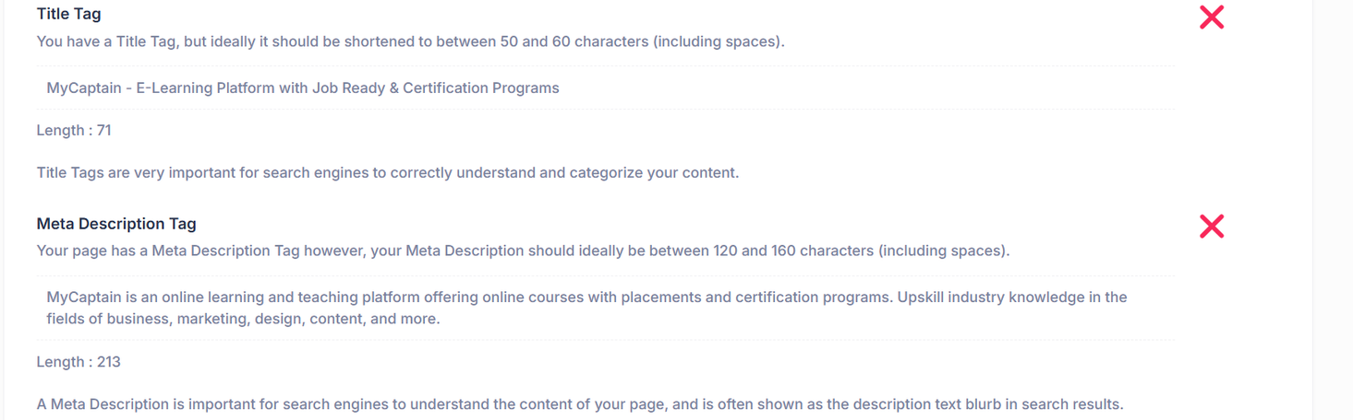
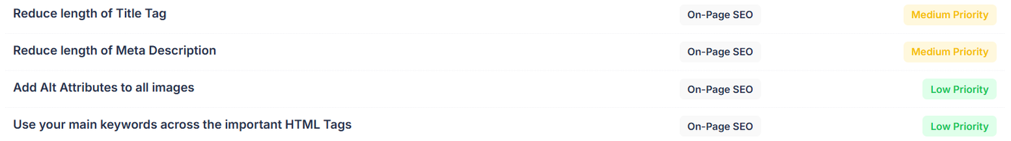
On - page SEO Audit

Slide 6
Issues (SEOptimer)
Non-optimized title tag and meta description
Keyword Consistency
Weak H1 without target keyword
Lack of SEO-focused content
Missing image ALT text
Poor internal linking with generic anchor text

Slide 7
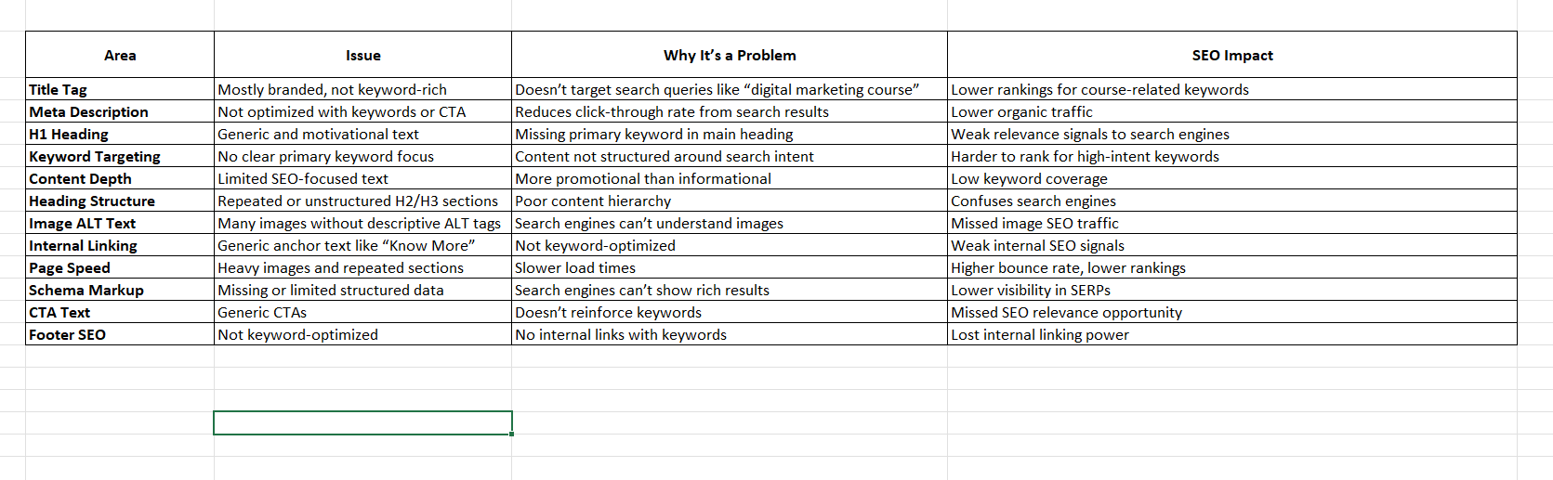
Issues (SEOptimer)

Slide 8
Solutions
Optimize title tag, meta description, and H1
Add SEO-focused content section (500–800 words)
Fix image ALT tags and internal links
Add schema markup

Slide 9
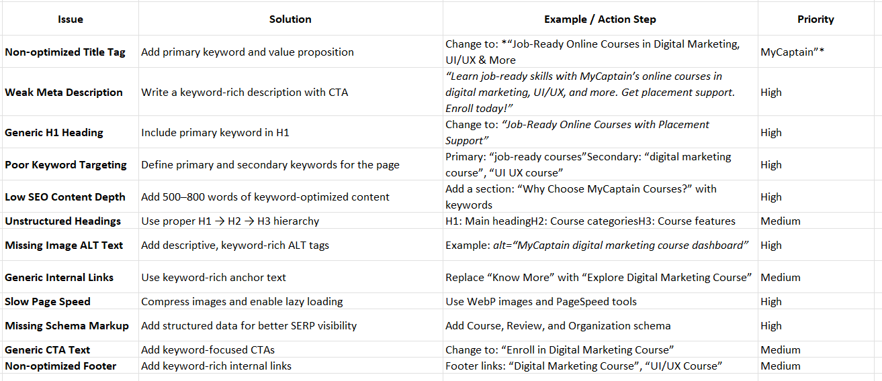
Solutions

Slide 10
Conclusion
The on-page SEO audit of the MyCaptain homepage shows that the website has a strong design, clear course offerings, and good trust signals. However, several important SEO elements are not fully optimized. Key issues include a non-optimized title tag and meta description, a generic H1 heading, weak keyword targeting, limited SEO-focused content, missing image ALT text, and generic internal linking.
By implementing the recommended solutions—such as optimizing the title and meta description, adding keyword-rich headings and content, improving internal links, compressing images, and adding schema markup—the website can significantly improve its search engine visibility and organic traffic.
Overall, with a few strategic on-page SEO improvements, MyCaptain has strong potential to rank higher for course-related keywords and attract more qualified users.

